Slide 1
Data, Environment and Society Lecture 6: Exploratory Data Analysis and Visualization
September 6, 2018
Instructor: Duncan Calllaway
GSI: Seigi Karasaki

Slide 2
Announcements
Reminder – github is where to git information
https://github.com/ds-modules/ER-190C
Late policy:
All homeworks submitted late will not be graded
You may request a two day extension twice in the semester
Coordinate through Seigi
Lab 2 due tomorrow, HW2 due Tuesday.
Reading next week (posted in github repo)
Tuesday: Goldemberg et al. Look at readme.md file for instructions
Thursday: DS100 Ch6 textbook

Slide 3
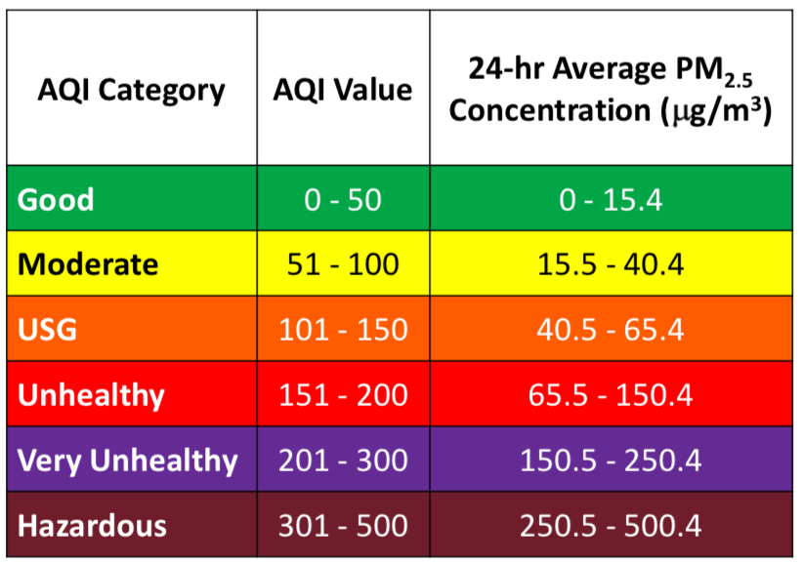
How do we measure PM2.5 concentrations?
Two options:
Raw measurement: micrograms per cubic meter
AQI: scaled version of the same measure
Where do you think the AQI scale comes from?
EPA bureaucrats take recommendations from “Clean Air Scientific Advisory Committee”
Science on the topic does not have significant causal support
Source: epa.gov

Slide 4
Today…
Merge
Groupby
Pivot
Energy and development
Discuss Groh et al

Slide 5
Merge
(borrowed from DS100 notes)

Slide 6
Joining two tables
OrderNum | ProdID | Name
1 | 42 | Gum
2 | 999 | NullFood
2 | 42 | Towel
OrderId | Cust Name | Date
1 | Joe | 8/21/2017
2 | Arthur | 8/14/2017
x
Left “key”
Right “key”
OrderNum | ProdID | Name | OrderId | Cust Name | Date
1 | 42 | Gum | 1 | Joe | 8/21/2017
1 | 42 | Gum | 2 | Arthur | 8/14/2017
2 | 999 | NullFood | 1 | Joe | 8/21/2017
2 | 999 | NullFood | 2 | Arthur | 8/14/2017
2 | 42 | Towel | 1 | Joe | 8/21/2017
2 | 42 | Towel | 2 | Arthur | 8/14/2017
Drop rows that don’t match on the key

Slide 7
Joining two tables
OrderNum | ProdID | Name
1 | 42 | Gum
2 | 999 | NullFood
2 | 42 | Towel
OrderId | Cust Name | Date
1 | Joe | 8/21/2017
2 | Arthur | 8/14/2017
x
Left “key”
Right “key”
OrderNum | ProdID | Name | OrderId | Cust Name | Date
1 | 42 | Gum | 1 | Joe | 8/21/2017
1 | 42 | Gum | 2 | Arthur | 8/14/2017
2 | 999 | NullFood | 1 | Joe | 8/21/2017
2 | 999 | NullFood | 2 | Arthur | 8/14/2017
2 | 42 | Towel | 1 | Joe | 8/21/2017
2 | 42 | Towel | 2 | Arthur | 8/14/2017
Drop rows that don’t match on the key
OrderNum | ProdID | Name | OrderId | Cust Name | Date
1 | 42 | Gum | 1 | Joe | 8/21/2017
2 | 999 | NullFood | 2 | Arthur | 8/14/2017
2 | 42 | Towel | 2 | Arthur | 8/14/2017

Slide 8
Groupby and pivot
(also borrowed from DS100 notes)

Slide 9
Manipulating Granularity: Group By
Key
Data
A
A
3
3
B
B
1
1
C
C
4
4
A
A
1
1
B
B
5
5
C
C
9
9
A
A
2
2
B
B
6
6
C
C
5
5

Slide 10
Manipulating Granularity: Group By
Key
Data
A
3
A
3
A
1
B
B
1
1
A
2
C
C
4
4
A
1
B
B
5
5
C
C
9
9
A
2
B
B
6
6
C
C
5
5

Slide 11
Manipulating Granularity: Group By
Key
Data
A
3
A
3
A
1
B
1
A
2
C
4
A
1
B
1
Split into
Groups
B
5
B
5
C
9
B
6
A
2
C
4
B
6
C
9
C
5
C
5

Slide 12
Manipulating Granularity: Group By
Key
Data
A
3
A
3
Aggregate
Function
A
A
6
A
1
6
B
1
A
2
C
4
A
1
B
1
Split into
Groups
Aggregate
Function
B
B
12
B
5
B
5
12
C
9
B
6
A
2
C
4
B
6
Aggregate
Function
C
9
C
C
18
18
C
5
C
5

Slide 13
Manipulating Granularity: Group By
Key
Data
A
3
A
3
A
1
Aggregate
Function
A
6
B
1
A
2
C
4
A
6
A
1
B
1
Split into
Groups
Merge
Results
B
12
B
5
B
5
Aggregate
Function
B
12
C
18
C
9
B
6
A
2
C
4
B
6
Aggregate
Function
C
9
C
18
C
5
C
5

Slide 14
Manipulating Granularity: Pivot
Key R
Key
C
Data
A
A
U
U
3
3
B
B
V
V
1
1
C
C
U
U
4
4
A
A
V
V
1
1
B
B
U
U
5
5
C
C
V
V
9
9
A
A
U
U
2
2
B
B
V
V
6
6
D
D
U
U
5
5

Slide 15
Manipulating Granularity: Pivot
Key R
Key
C
A
U
3
Data
Aggregate
Function
A
U
5
A
U
3
A
U
2
B
V
1
Aggregate
Function
A
V
1
A
V
1
C
U
4
Aggregate
Function
B
U
5
B
U
5
A
V
1
Split into
Groups
B
V
1
Aggregate
Function
B
V
7
B
U
5
B
V
6
C
V
9
C
U
4
Aggregate
Function
C
U
4
A
U
2
C
V
9
Aggregate
Function
C
V
9
B
V
6
D
U
5
D
U
5
Aggregate
Function
D
U
5

Slide 16
Manipulating Granularity: Pivot
Key R
Key
C
A
U
3
Data
Aggregate
Function
A
U
5
A
U
5
A
U
3
A
U
2
B
V
1
Aggregate
Function
A
V
1
A
V
1
A
V
1
C
U
4
Aggregate
Function
B
U
5
B
U
5
B
U
5
A
V
1
Split into
Groups
B
V
1
Aggregate
Function
B
V
7
B
U
5
B
V
7
B
V
6
C
V
9
C
U
4
Aggregate
Function
C
U
4
C
U
4
A
U
2
Aggregate
Function
C
V
9
B
V
6
C
V
9
C
V
9
D
U
5
D
U
5
Aggregate
Function
D
U
5
D
U
5

Slide 17
Manipulating Granularity: Pivot
Key R
Key
C
A
U
3
Data
Aggregate
Function
A
U
5
A
U
3
A
U
2
B
V
1
Aggregate
Function
A
V
1
A
V
1
V
U
V
C
U
4
Aggregate
Function
B
U
5
B
U
5
U
A
1
A
5
A
V
1
Split into
Groups
B
V
1
Aggregate
Function
B
V
7
B
5
7
B
U
5
V
B
V
6
C
V
9
C
4
9
C
U
4
Aggregate
Function
C
U
4
U
D
5
A
U
2
Need to address missing values
Aggregate
Function
C
V
9
B
V
6
C
V
9
V
D
U
5
D
U
5
Aggregate
Function
D
U
5
U

Slide 18
Let’s take the quiz

Slide 19
Energy and Development

Slide 20
Overview
Next few weeks of data analysis focus on electricity access and living conditions at the country level.
Today we’ll give a very broad overview of the issues, with an eye toward understanding
Data provenance
Causal vs. non-causal relationships

Slide 21

Notes:
This is Kibera, a slum in Nairobi, Kenya
In many ways typical extreme challenges of this environment – structures are in poor condition, basic roads with streets difficult to maintain. But trappings of other things – expensive Mercedes, some cranes for building modern buildings in the background.
This photo was taken several years ago
I was there over the summer, and took the next photo…

Slide 22

Notes:
Here is Kibera from a photo taken this summer – what’s different?
Something we’ll focus on in the coming weeks is the relationship between electricity access and living conditions in different countries.
In this case, World Bank reimbursed Kenya Power and Light for every connection they made. The premise is that electricity access is a basic human need and generates opportunities for improved economic development.
Kenya power attempted to give formal access to every one of the residents of Kibera. But the problem…is that there are other ways to get access to energy.

Slide 23
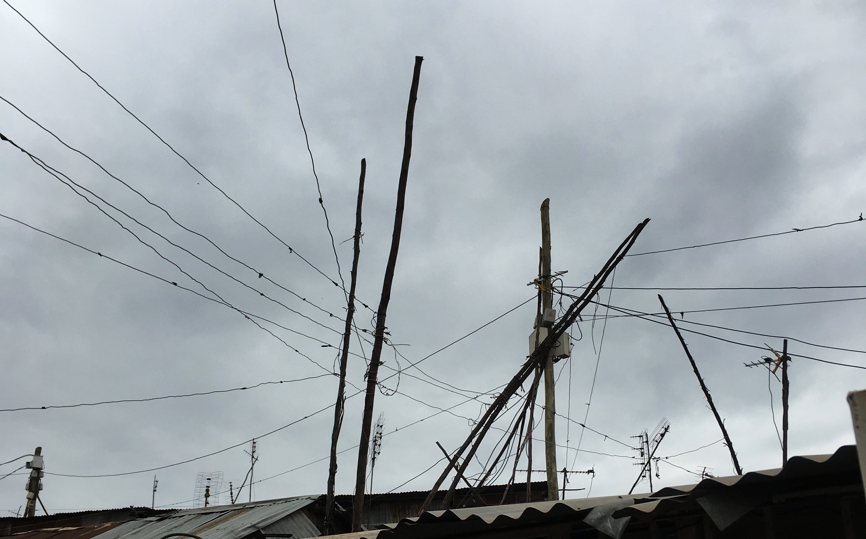
Notes:
But there are other means to get electricity – here we have “informal” electricity access. Cartels steal from the main infrastructure, unmetered, and send it to people who pay them a monthly “access” fee using old phone wires and other unsafe

Slide 24

Notes:
Main point of this picture: there is an abundance of roof area for solar, if this community chose it and had the resources to install.
There are plenty of people in Kibera thinking about doing this…

Slide 25

Notes:
This young man meets people as they exit an (oil powered) bus with a bag of charcoal (biomass) for sale using his (human powered) bike for transport.
The point is that electricity is not the only means for distributing and consuming energy, particularly in low income countries.
Let’s dig a little further into how to think about energy and development.

Slide 26
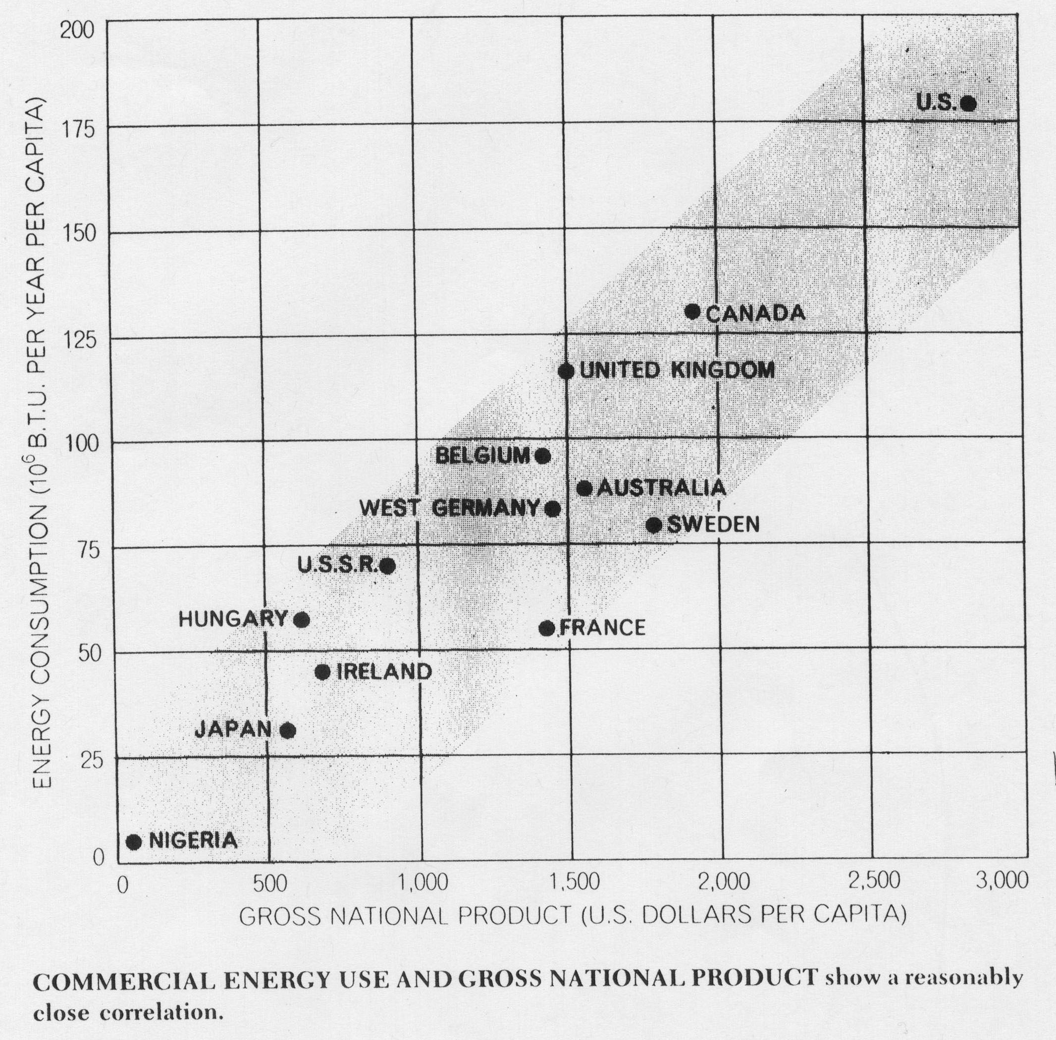
Source: Scientific American Special Issue on energy 1970
Notes:
This image from nearly 50 years ago captures how people were thinking about the connections between energy and development at the time.
Note here we are talking about total energy consumption, not just electricity. Let’s talk a little more about units

Slide 27
Energy units of measure:
Building blocks:
Joule: energy required to heat one gram of water 0.24 degree Celsius
About 120,000,000 joules in a gallon of gas
BTU: energy required to heat one pound of water 1 degree farenheit
1 BTU = 1,056 Joules
So a gallon of gas is…about 115,000 BTU

Slide 28
Different units for different scales
Used to measure personal electricity consumption: kWh
kWh = 3,600,000 J, 1000 joule per second sustained for one hour
Also equal to 3,412 Btu
Refrigerators use about 0.2 kWh in an hour.
Houses in the US: ~10,000 kWh per year
GJ (gigajoule) = 277.8 kWh
Used to measure nation-level energy:
Ton of oil equivalent: unit of measure to catalog nation-level energy consumption
1 ToE = 11,630 kWh, or about 40 million Btu.
About 5 ToE per person per year in the US.
In the US
Quad: 1 quadrillion (10^15) BTU

Slide 29
Forms of energy people use
Electricity
1 kWh = 3,412 BTU
Can be produced from a variety of sources including hydro, nuclear, coal, natural gas, renewable sources.
Gasoline
1 gallon = 115,000 BTU, or 33.70 kWh
Natural gas
1 therm = 100,000 BTU, or 29.3 kWh
Wood
1 lb of hardwood ~ 6,000 BTU, or 1.75 kWh
Dung
1 lb of dung ~ 5,000 BTU or 1.45 kWh
Important: all of these things can be measured in the same units

Slide 30
Power vs energy
Watts are units of power, equal to joules per second.
kW, MW, GW are all units of power, not energy!
Notes:
Image source: https://fathertheo.wordpress.com/2013/09/29/a-climate-energy-vocabulary/

Slide 31
Bare-Bones Energy for Development
Energy services = heating/cooking + lighting + other
Heating/Cooking = 1 ton wood/person/year (observed, East Africa)
(20 GJ/ton @ 5% eff. = 1 GJ/cap/year)
1 GJ/useful energy (MINES, India)
~ 5 GJ energy/year (rural Mexico)
> 300 kWh/person/year
Lighting = (50 W) • (6 hours/day) (30 days) = 10 kWh/month, or 120kWh/yr
= 120 kWh/person/year; round down, 100 kWh/cap/yr
Other elec, e.g… refrigeration (50 W) • (5 hrs/day) • (5 people/unit) = 20 kWh/yr
computing: (100 W) • (2 hrs/day) • (2/3 year) = 50 kWh/yr
= 100 - 200 kWh/person/year
Bare bones budget = 300 + 100 + 200 = 600 kWh/person/year
(and at least 300 kWh/person/year of electricity services)
A useful equivalence to know is 1 GJ ~ 280 kWh, depending on conversion efficiency.

Slide 32
Groh et al reading questions for discussion
What is the multi-tier framework for energy access? What agency developed it?
What alternative metrics are used to measure electricity access?
Consider ”percent electrified” versus MTF tier as measures of energy development.
How do they differ?
What advantages does one have over the other?
Notes:
1. MTF is a multidimensional measure of energy access, grouped into 5 tiers. Higher tiers are associated with greater supply (power and energy), reliability, affordability, legal service provision and health / safety.
One can apply MTF to a community or country by identifying what fraction of the prpoluation is in each Tier.
2. Alternative metrics: access percentage, service interruptions, minimum thresholds, country-level consumption.
3. Tradeoffs:
Percent electrified: easier to estimate.
MTF: harder to measure, but captures more
What if percent electrified is actually strongly correlated to MTF distributions. Whould it be a good idea to use it? [One thing to be careful about: the correlation may change over time. Also, you may find that there are important details in the portions of the data the models can’t explain.]

Slide 33
Climbing the Energy Ladder
GJ/capita
+$25k/capita: little ‘extra’ energy needed on average
350
300
U.S.
Australia
+$15k/capita:
services start to dominate growth
+$10k/capita: industrialization extensive
250
200
EU
150
Korea
Japan
100
China
Mexico
+$5k/capita: industrialisation and mobility take off
50
India
Brazil
Thailand
0
0
5
10
15
20
25
30
35
GDP/capita (‘000 2005$ PPP)
Source: IMF, BP
Notes:
A similar pattern can be seen across time and countries with respect to the relationship between energy demand and income. (See ‘Present in the Future’ in Energy Needs, Choices and Possibilities: Global Scenarios to 2050, for more information.)
At least three issues arise: 1) Will energy demand grow more or less quickly than in the past? We should not be surprised to see global energy demand grow more quickly over the next two decades than the past two, as countries like India and China enter rapid phases of energy demand growth and the Former Soviet Union demand recovers.
2) Which path will India and China, as late developers, follow? They may need less energy than the EU or Korea at similar income levels. More efficient end-use technology, such as chemical processes, steel production and vehicles, is available at lower cost.
3) Is it possible that per capita energy demand could ultimately saturate, somewhere beyond $30000 per capita? Yes, it is possible to see a saturation of large energy end uses, with small additional energy demand growth offset by ongoing efficiency improvements. This is an important issue for long- term energy demand.

Slide 34
White’s Law
(an antiquated, overly simplified caricature of the relationship between energy and living conditions)
“Culture advances as the quantity and quality of energy used increases. This relationship can be captured formally as an equation.”
C = k x E x T
Leslie White, 1973
C = culture
E = energy
T = technology
k = scaling (efficiency) constant
Notes:
There are a number of problems here.
“culture” is a relative, culturally loaded term. Is my culture better than yours?
Energy use could be extremely inefficient --

Slide 35
Though White’s law is too simplistic and culturally tone deaf…
It does capture a general belief that energy (and electricity) consumption support basic economic development.
But the direction of causality is unclear. Certainly some growth in consumption happens when people have more expendable income.
…and energy consumption is clearly still rising in low income enomies

Slide 36
Emerging economies drive global energy demand
Growth in primary energy demand
4 500
Mtoe
4 000
China
3 500
India
3 000
Other developing Asia
2 500
Russia
2 000
Middle East
Rest of world
1 500
OECD
1 000
500
0
2010
2015
2020
2025
2030
2035
Global energy demand increases 1/3 from 2010 to 2035, with China & India accounting for 50% of the growth
Source: IEA WEO 2011

Slide 37
Difference In Responsibilities for Energy Resources (Shimla, India)
Fuel Type | Gender |  | Age
 | (%) |  | Survey Average
 | Male | Female | Male | Female
Dung cake | 4 | 96 | 57 | 34
Agri. Residue | 24 | 75 | 19 | 32
Wood | 38 | 62 | 53 | 29
Kerosene | 58 | 42 | 21 | 36
Cooking gas (LPG) | 92 | 8 | 29 | NA
Others fuels (kerosene …) | 60 | 40 | 51 | 41
Source: IRADe study, “The Energy Poverty and Gender Nexus in Himachal Pradesh, India: The Impact of Clean Fuel Access Policy on Women’s Empowerment” Survey of 24,500 households

Slide 38
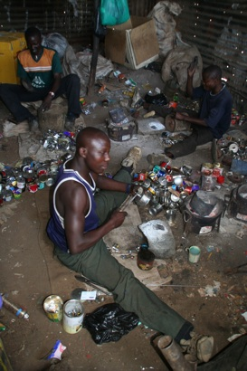

Tin lantern: $0.20 to buy …. $50/year to operate
Kenya: Tin lamp shop (Kibera)

Slide 39



Flames v. LEDs: like night & day
Flame
LED
One lux is equal to one lumen per m²:
1 lux = 1 lm/m² = 1 cd·sr·m^{–2}.
Flame: 0.1 lumens/watt • 1-10 lux
LED: 50 lumens/watt • 100-500 lux
Tanzania: street vendor (Dar es Salaam)

Slide 40
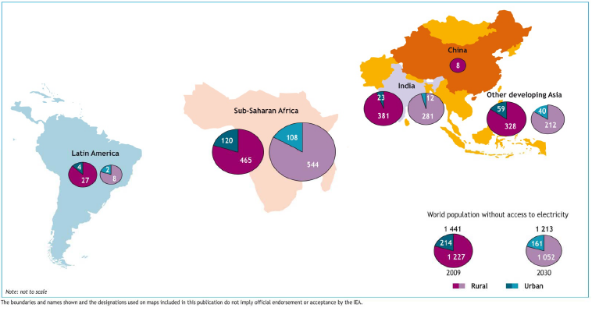
Unelectrified People (and fuel based lighting users) in Asia is Even Higher than in Africa
Africa: ̴ 600 million
Americas: ̴ 30 million
Asia: ̴ 800 million
Source: IEA, 2010 World Energy Outlook

Slide 41
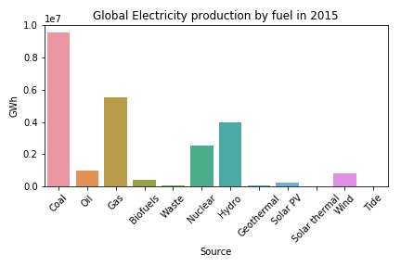
Where will this electricity come from?
Notes:
Data source: IEA

Slide 42
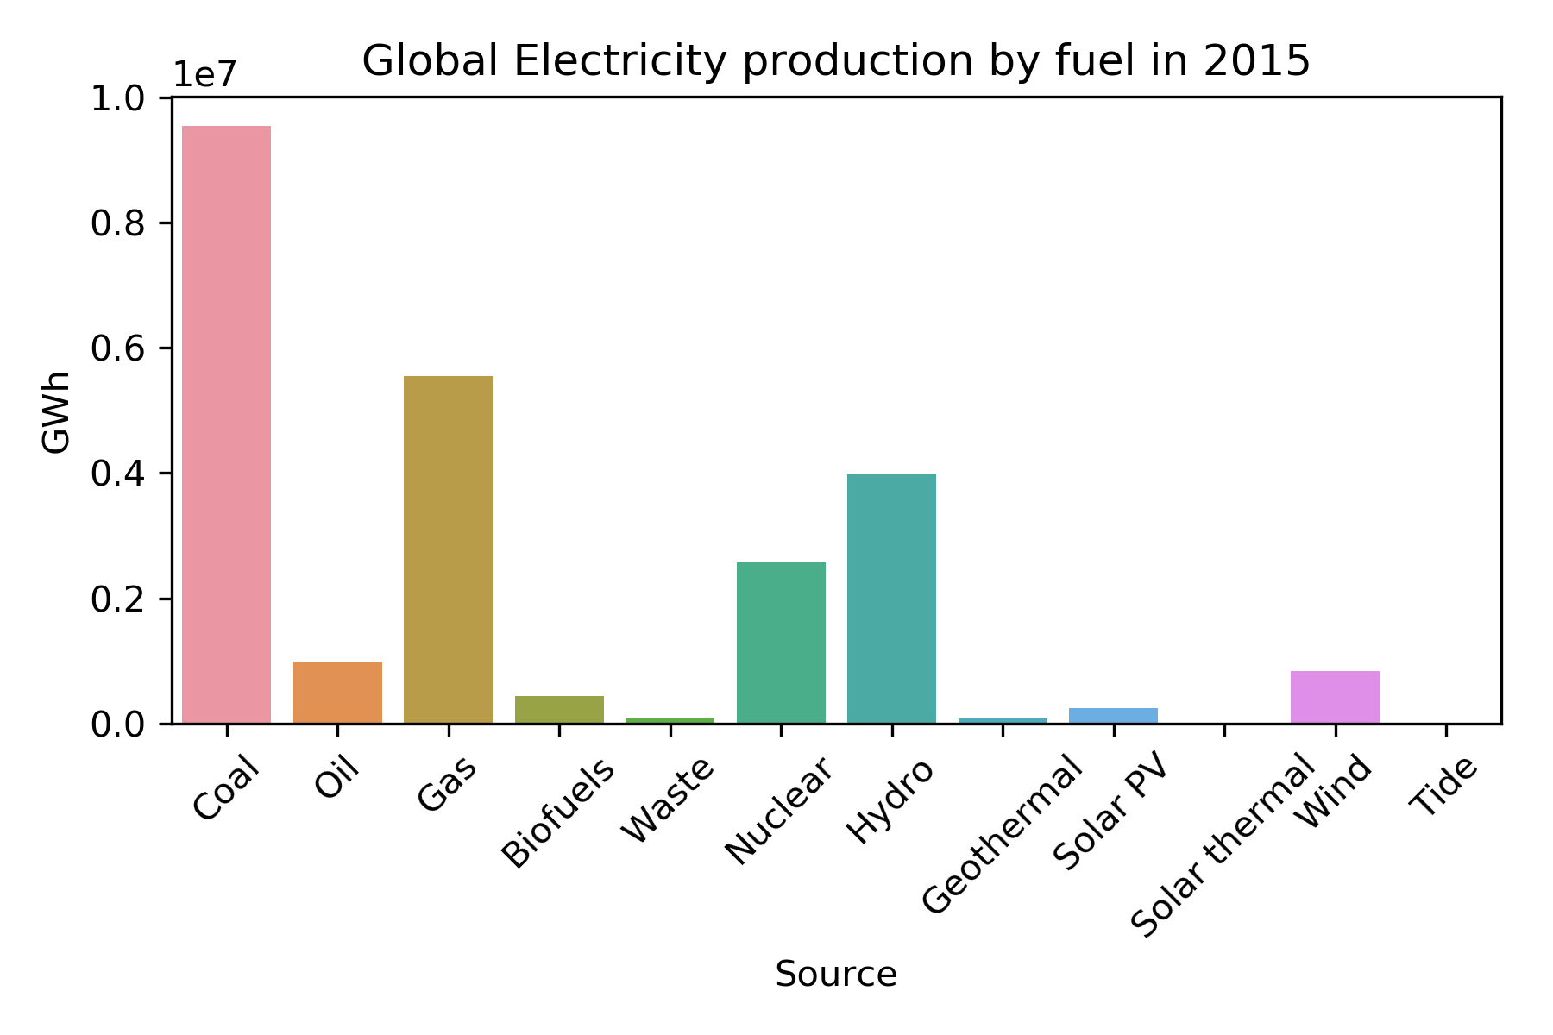
Where will this electricity come from?
Notes:
Data source: IEA

Slide 43
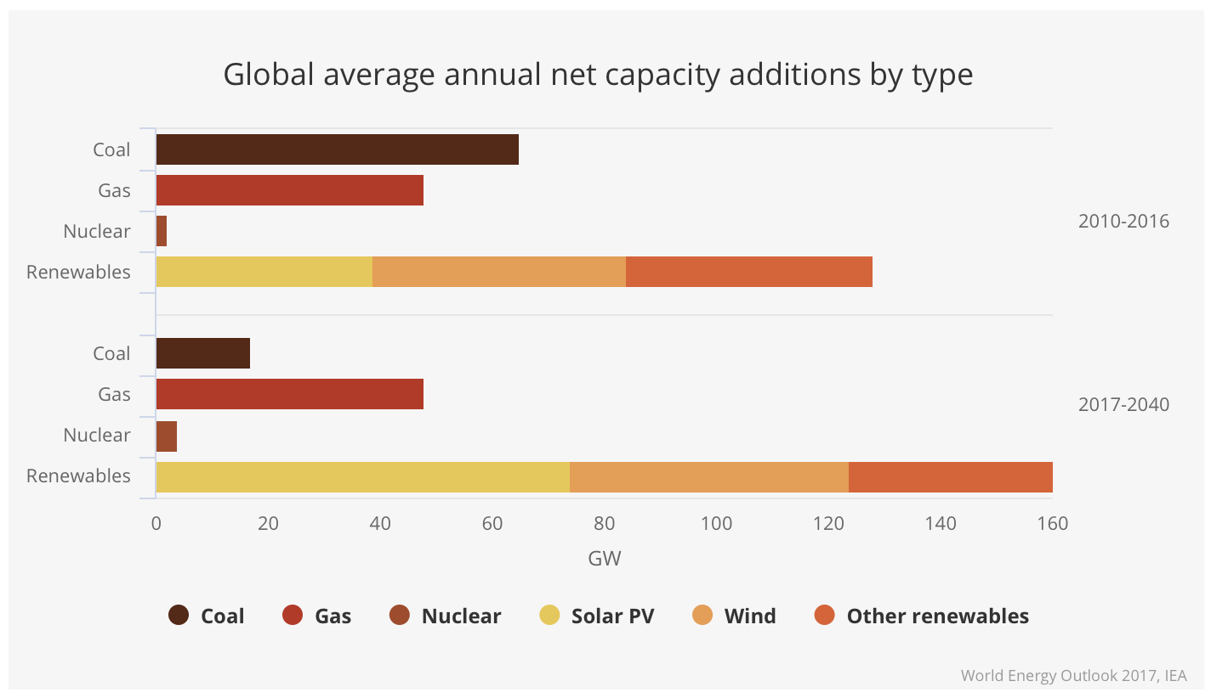
But the story is changing!

